Slide 1
MATHEMATICS I
FIRST SEMESTER
01
Preliminaries
By Dr. Shaimaa Amen/Material engineering Department
1st Grade/Calculus I

Slide 2
Outlines
Basics
Real Numbers and the Real Line
  Real Numbers
  Intervals
  Solving Inequalities
  Absolute Value
Lines
  Cartesian Coordinates in thePlane
  Straight Lines (point-slope equation, slope-intercept equation)
  Parallel and Perpendicular Lines
  Distance in the Plane

Slide 3
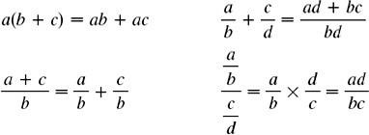

Basics
Arithmetic Operations
Factoring Special Polynomials

Slide 4
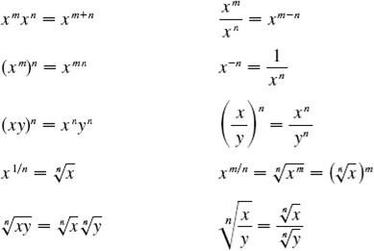

Exponents and Radicals
Quadratic Formula

Slide 5
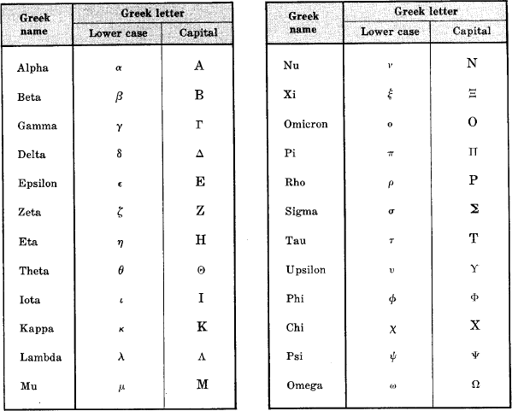
Greek Alphabet

Slide 6

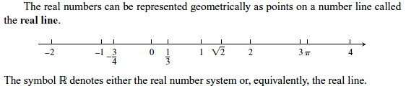
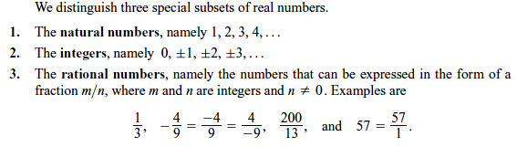
Real Numbers and the Real Line
Real Numbers
Much of calculus is based on properties of the real number system. Real numbers are numbers that can be expressed as decimals, such as

Slide 7
Intervals
A subset of the real line is called an interval if it contains at least two numbers and contains all the real numbers lying between any two of its elements. For example, the set of all real numbers x such that x > 6 is an interval, as is the set of all x such that -2 ≤ x ≤ 5 The set of all nonzero real numbers is not an interval; since 0 is absent, the set fails to contain every real number between-1 and 1 (for example).
Geometrically, intervals correspond to rays and line segments on the real line, along with the real line itself. Intervals of numbers corresponding to line segments are finite intervals; intervals corresponding to rays and the real line are infinite interval .
Solving Inequalities:
The process of finding the interval or intervals of numbers that satisfy an inequality in x is called solving the inequality.

Slide 8
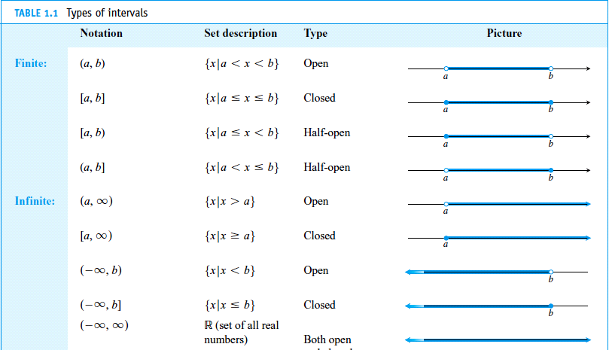

Slide 9
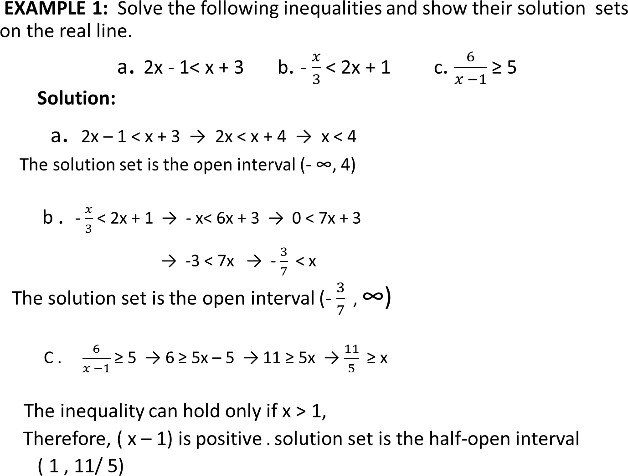




Slide 10
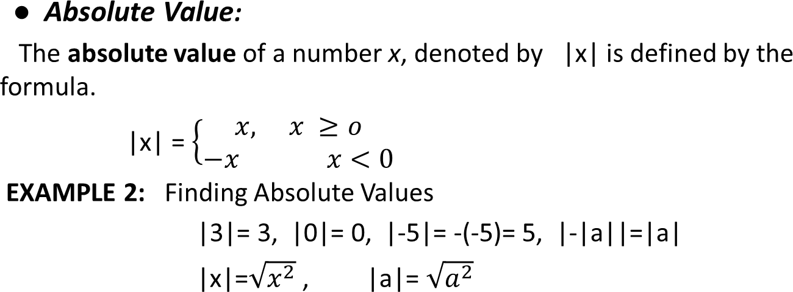
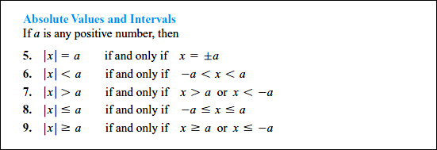

Slide 11
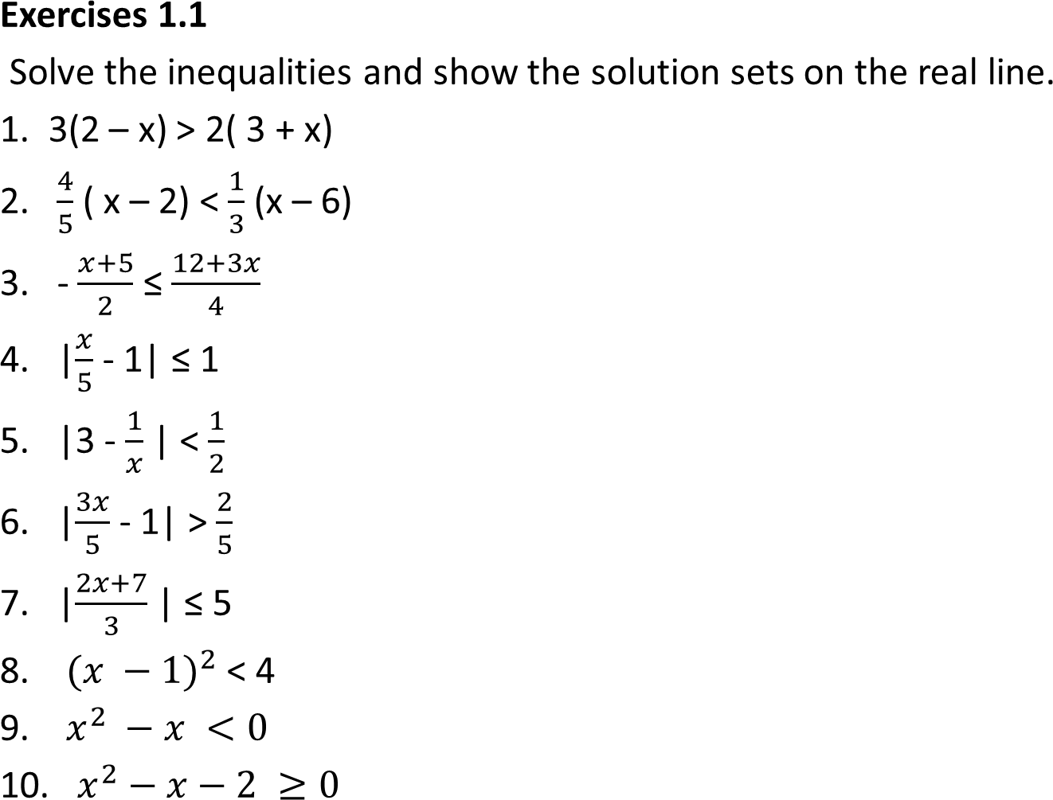
Exercises 0.0

Slide 12
MATHEMATICS I
FIRST SEMESTER
02
The Real Numbers & the Real Line
By Dr. Shaimaa Amen/Material Engineering Department
1st Grade/Calculus I

Slide 13
Lines
”This section reviews coordinates, lines, and distance.
CartesianCoordinatesin the Plane:
draw two perpendicular coordinate lines that intersect at the 0-point of each line. These lines are called coordinate axes in the plane. On the horizontal x-axis, numbers are denoted by x increase to the right. On the vertical y-axis, numbers are denoted by y and increase upward (Figure 1). Thus “upward” and “to the right” are positive directions, whereas “downward” and “to the left” are considered as negative.
The origin O, of the coordinate system is the point in the plane where x and y are both zero. If P is any point in the plane write P(a, b). This coordinate system is called the rectangular coordinate system or Cartesian coordinate system this coordinate divide the plane into four regions called quadrants, as shown in Figure 2.

Slide 14
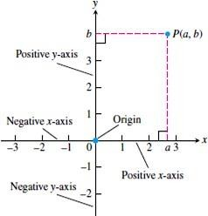
Figuer 1. Cartesian coordinates in the plane are based on two perpendicular axes intersecting at the origin

Slide 15
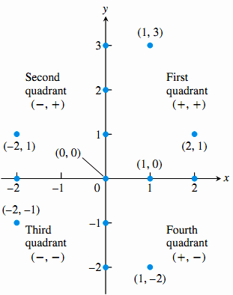
Figure 2. Points labeled in the xy-coordinate or Cartesian plane. The points on the axes all have coordinate pairs but are usually labeled with single real numbers, (so (1, 0) on the x-axis is labeled as 1). Notice the coordinate sign patterns of the quadrants.

Slide 16
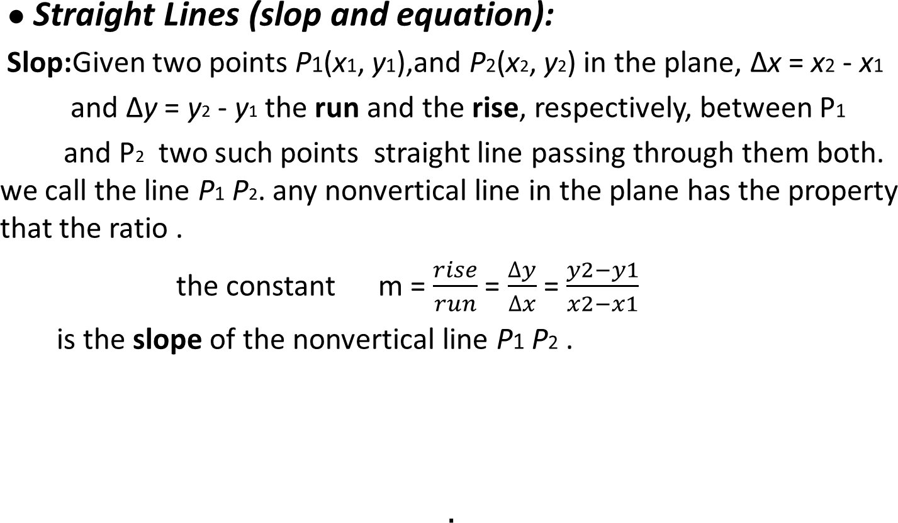
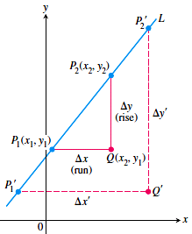

Slide 17
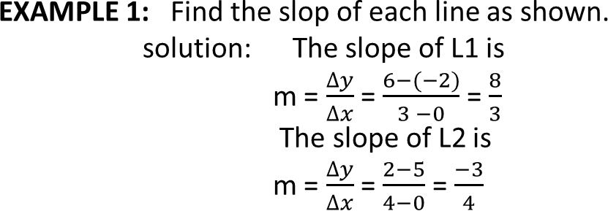
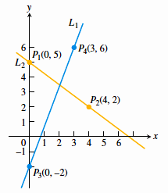
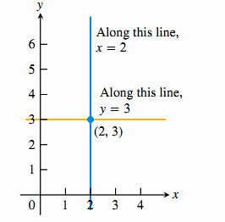
Straight lines have relatively simple equations. All points on the vertical line through the point a on the x-axis have x-coordinates equal to a. Thus, x=a is an equation for the vertical line.
Similarly, y = b is an equation for the horizontal line meeting the y-axis at b. (See Figure 3.)
Figure 3 The standard equations for the vertical and horizontal lines through (2, 3) are and y = 3. x = 2

Slide 18
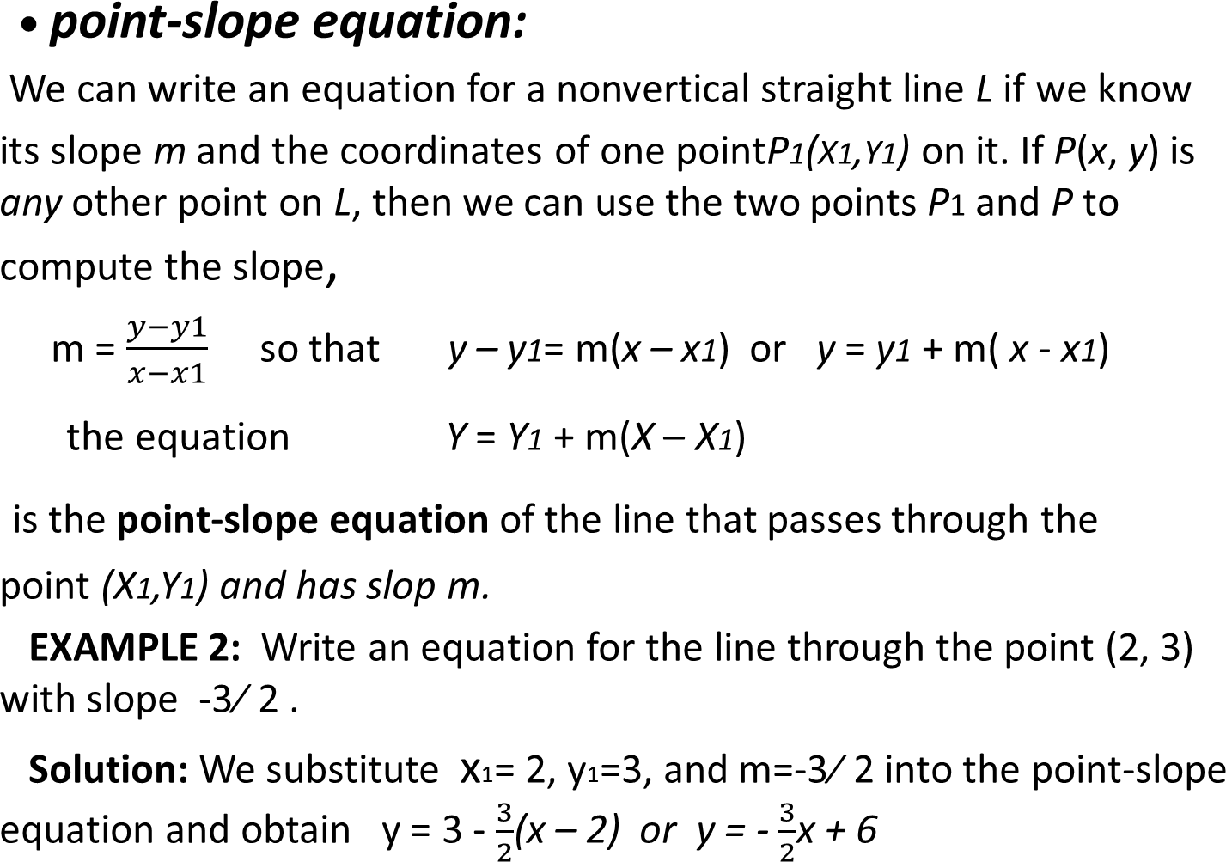

Slide 19
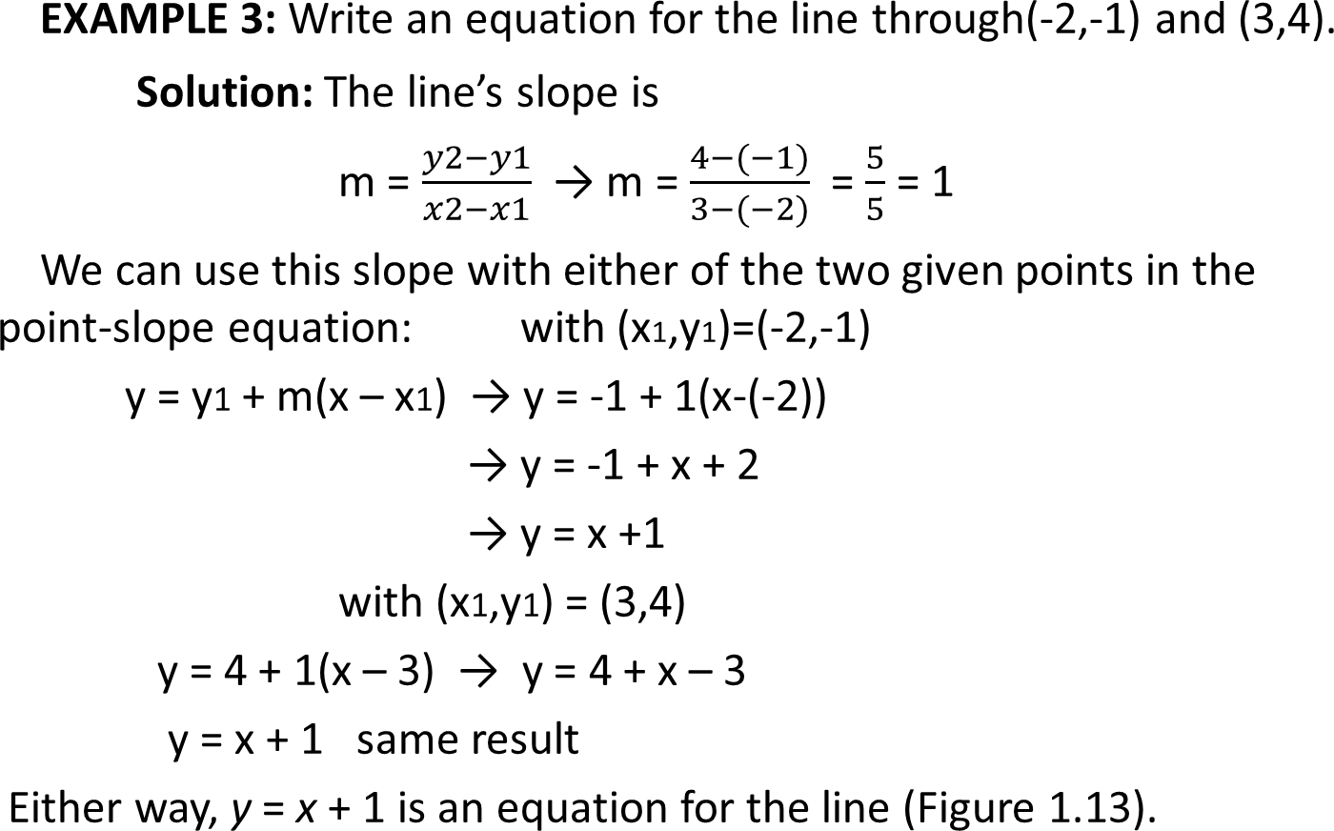
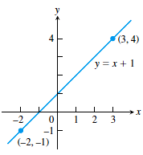

Slide 20
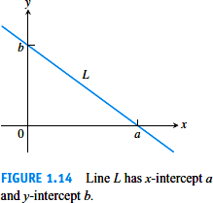
Slope-intercept equation:
The y-coordinate of the point where a nonvertical line intersects the y- axis is called the y-intercept of the line. Similarly, the
x-intercept of the line (Figure 1.14). A line with slope m and
y-intercept b passes through the point (0, b), so it has equation.
y = b + m(x – 0)
the equation y = mx +b
is called the
slop-intercept equation of the line with slop m and y-intercept b.
Note: Lines with equations of the form y + mx have y-intercept 0 and so
pass through the origin.

Slide 21
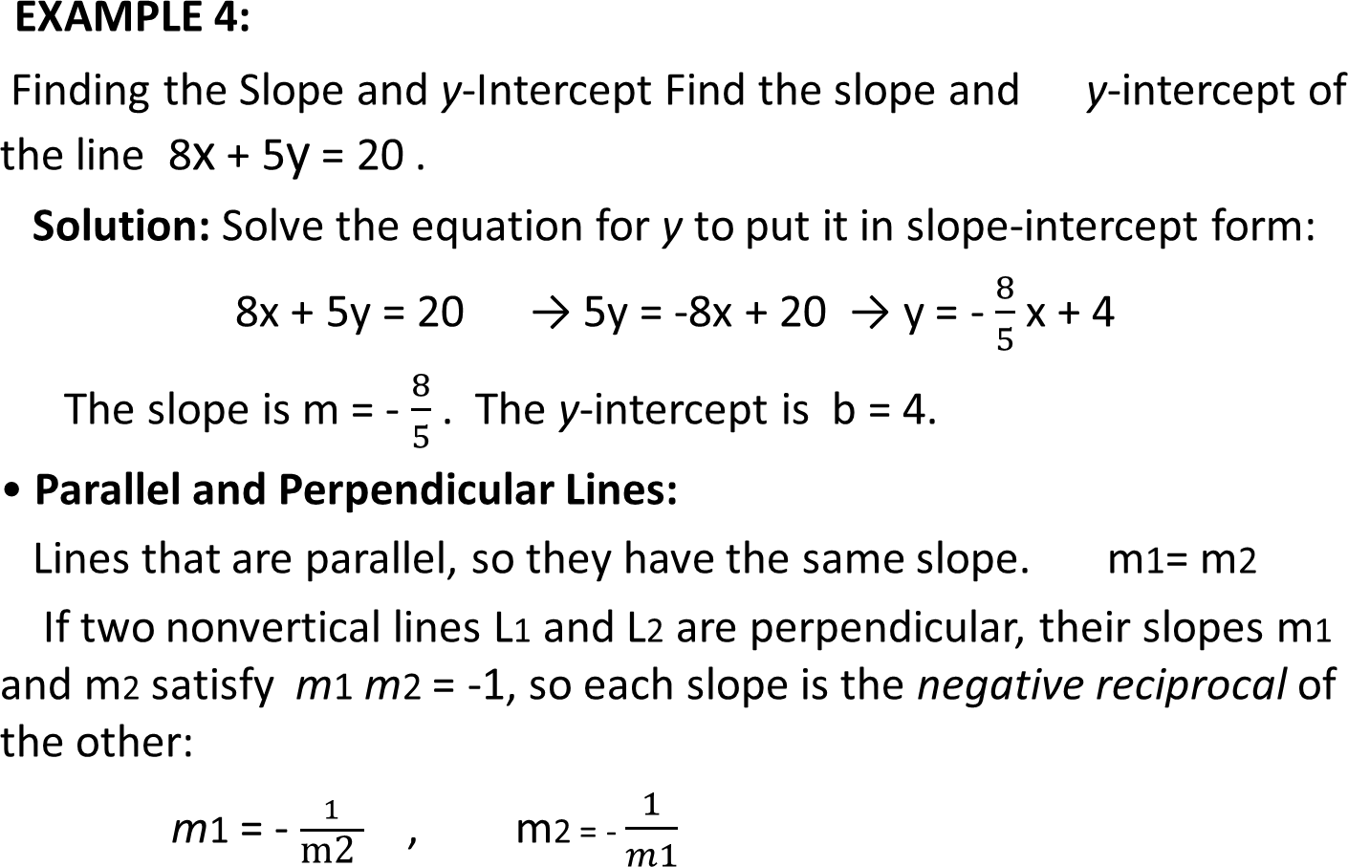

Slide 22
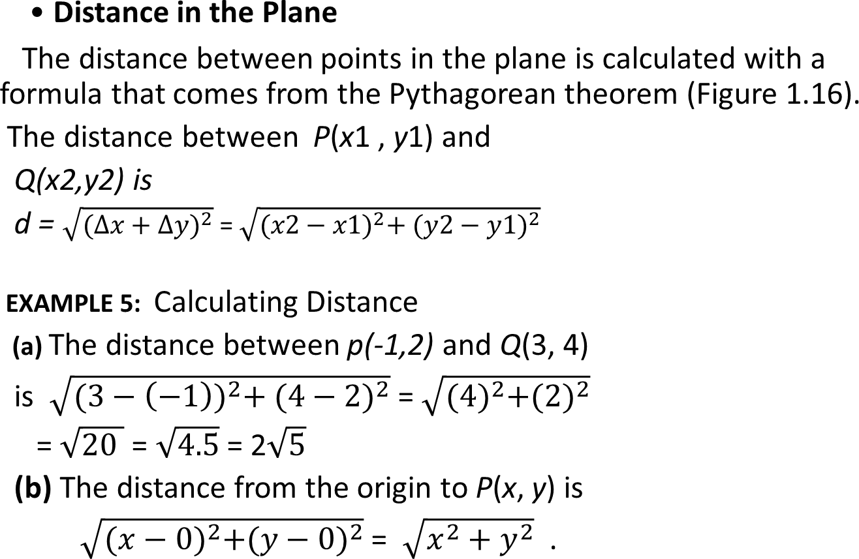
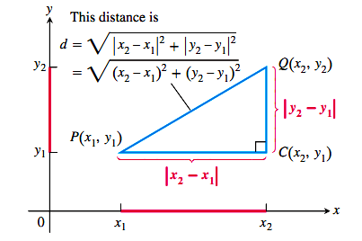
Figure 4 To calculate the distance between P(x₁,y₁)and Q(x₂,y₂)apply the Pythagorean theorem to riangle PCQ.

Slide 23
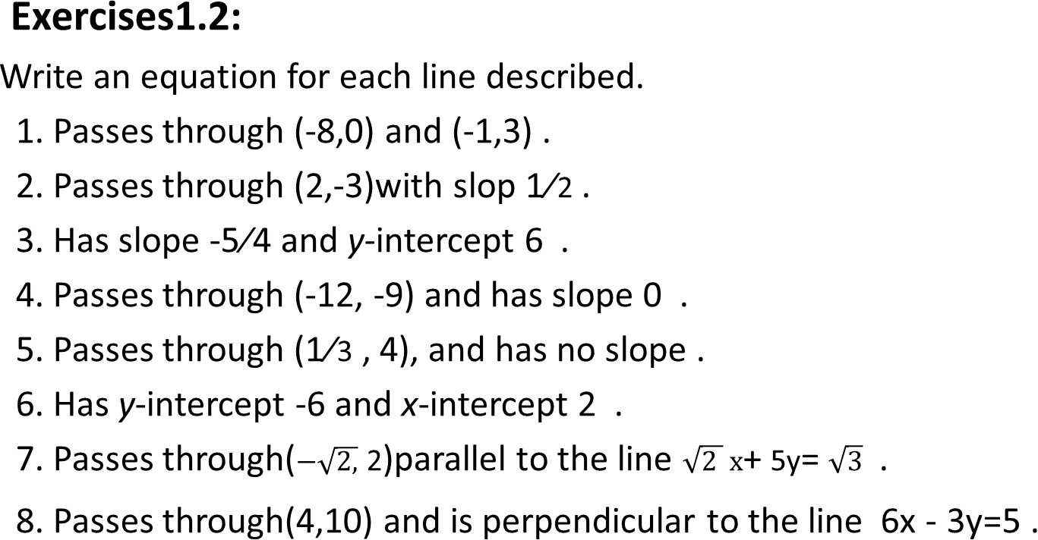
Exercises 0.1

